Slide 1
Fintech AB
2022
The #1 robo-advisor
Team with previous exits of USD 3 billion
has launched the most intelligent and cheapest robo-advisor
Financing round: EUR 1 million
Valuation: EUR 5 million
Stockholm 2020
Material provided by Fintech AB CONFIDENTIAL & PROPRIETARY I Any use of this material without any specific permission of Fintech AB is strictly forbidden

Slide 2
Fintech AB
2022
Personalized investment advice is expensive and not accessible to everyone
Consumer often have to pay high fees and many can’t get access to private banking
PROBLEMS
No access: Many investors don’t have access to private banking
Expensive and slow: Private banking is still expensive and seldom updates your portfolio
High fees: Actively managed funds have high fees
Financing Round I Fintech AB

Slide 3
Fintech AB
2022
Fintech offers a simple solutions for investors
By investing via Fintech the customer gets a diversified portfolio with the market’s highest returns and lowest fees
SOLUTION
Diversified portfolio
By investing in Fintech you get access to the whole market with a suitable allocation
High yield
Fintech’s algorithms find the investments with the highest risk-adjusted returns
Low fees
By utilizing Blockchain, Fintech is able to provide the lowest fees on the market
Financing Round I Fintech AB

Slide 4
Fintech AB
2022
Fintech already has strong traction with a growing customer base, high LTV and low churn rate
TRACTION
1 500 investors are using the platform
22 700
average lifetime
value of an
investor in SEK
0.2 %
average
monthly churn rate
Financing Round I Fintech AB

Slide 5
Fintech AB
2022
Via its advanced algorithms, Fintech’s share-based, long-term option has outperformed the market with 200%
TRACTION
28.2%
14.1%
S&P 500 average annual percentage change 2017-2019
Fintech share-based, long-term option’s average annual percentage change 2017-2019
Financing Round I Fintech AB

Slide 6
Fintech AB
2022
Fintech’s revenue has grown steadily since its start in 2018
USD 2m
TRACTION
USD 700k
USD 200k
2018
2019
2020
Financing Round I Fintech AB

Slide 7
Fintech AB
2022
Fintech’s is projecting USD 20 million in revenues by 2023 with a profit margin > 80 %
USD 20m
REVENUE PROJECTIONS
USD 9m
USD 5m
2021
2022
2023
Financing Round I Fintech AB

Slide 8
Fintech AB
2022
A large and growing market
Retail investment market in Europe 2019
EUR 2 Bn
+ 8 % per year
Robo-advising market in Europe 2019
EUR 0.5 Bn
+ 24 % per year
Robo-investment market in Sweden 2019
EUR 0.1 Bn
+ 25 % per year
Source: Riksbanken, Penningpolitisk rapport, September 2019
Financing Round I Fintech AB

Slide 9
Fintech AB
2022
The size of the global market for robo-advisors is EUR 11 billion and growing explosively with an annual growth rate of 24%
WHY IT’S A GOOD IDEA
Large market
The global market for robo-advisors is EUR 11 billion
Growing market
The global market for robo-advisors has an annual growth rate of 24%
High willingness
89 % of Americans either have or want to invest via a robo-advisor
Financing Round I Fintech AB

Slide 10
Fintech AB
2022
Fintech takes a cut of 0.1% from the investment amount
BUSINESS MODEL
Invested amount
USD 1 000 000
Fintech’s cut
0.1%
Fintech’s revenue
= USD 100
Financing Round I Fintech AB

Slide 11
Fintech AB
2022
Competing robo-advisors either have higher fees, lower return or another geographical focus
Fintech AB
Competitor A
Competitor B
Funding to date
Latest revenue
Location
Backers
Blockchain?
Fees below 0.5%?
Fully automated?
EUR 2.6 million
EUR 5 million
EUR 2.6 million
EUR 1.5 million
EUR 0.1 million
EUR 0.6 million
Stockholm
Berlin
Paris
EQT Ventures
Sequoia Capital
Klarna
No
Yes
No
No
No
No
No
Yes
Yes Yes
Yes
Yes
No
Yes Yes
Yes
No
Yes
Yes
Financing Round I Fintech AB
Yes

Slide 12
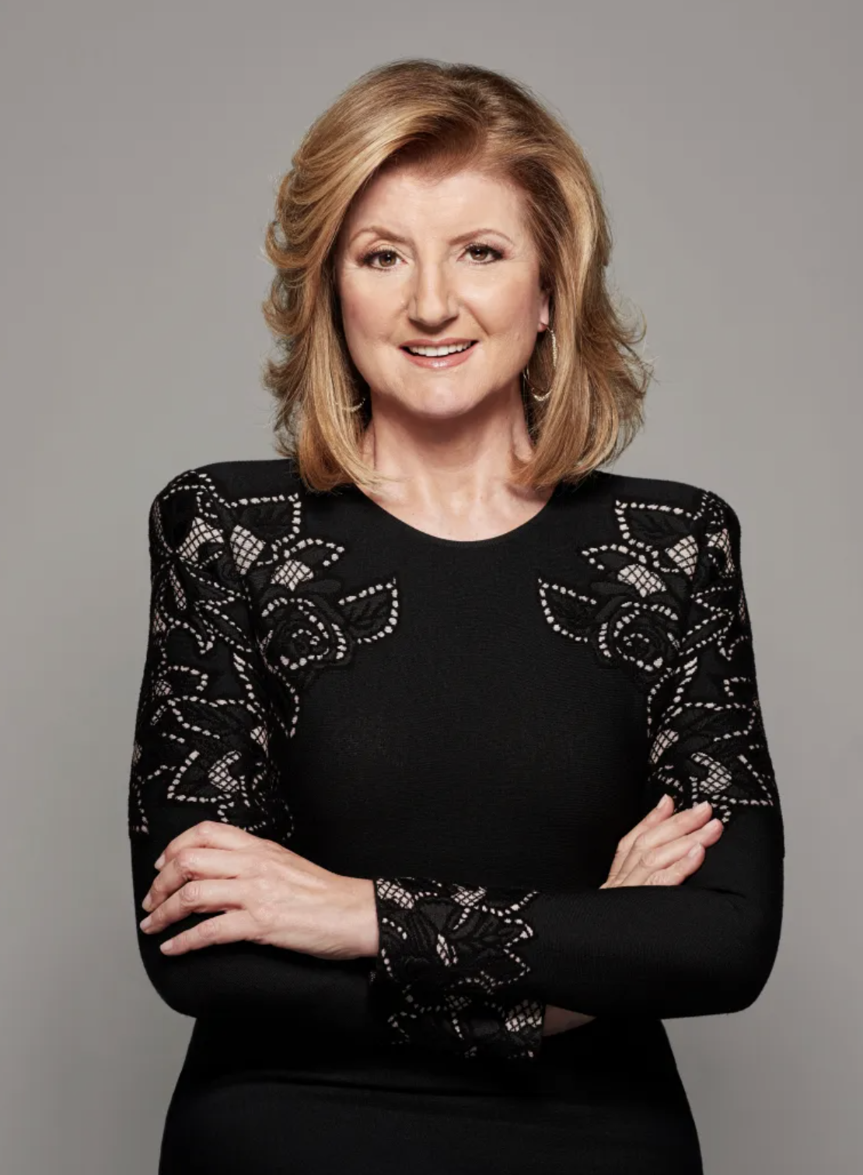
Fintech AB
2022
Meet The founder.
Founder with a proven track record
Name Arianna Huffington
Role Founder & CEO
Experience Started Huffington Post
which was acquired for
X millions.
Financing Round I Fintech AB

Slide 13
Fintech AB
2022
Meet the team.
Former CEO’s of Europe’s largest private banking firms and Blockchain developers
who have built software together for +15 years
Management team
Name: Oprah Winfrey
Role: CFO
Previously: founder of Harpo Productions. Scaled business from EUR X millions to EUR X millios
Name: Kylie Jenner
Role: CMO
Previously: founder of Kylie Cosmetics which was acquired for EUR X millions
Name: Sara Blakely
Role: CIO
Previously: founder of Spanx, increased revenues by 100 %
Name: Sheryl Sandberg
Role: COO
Previously: COO at Facebook, experienced board member in the
fin-tech industry
Financing Round I Fintech AB

Slide 14
Fintech AB
2022
Fintech is seeking to raise EUR 1 million (60 % committed) to expand the team and scale internationally
The offer
USE OF PROCEEDS
Seeking:
Pre-money valuation:
Ticket size:
USD 2 million
USD 5 million
USD 50k
Team (30 %)
Social-Media Marketing (35 %)
CAPTABLE OVERVIEW
R&D (35 %)
Management: 88 %
Investors:
12 %
Funding history
Pre-seed round: USD 500 000. Existing investors include EQT Ventures and Northzone
Financing Round I Fintech AB

Slide 15
Fintech AB
Fintech AB
2020
2020
Thank you!
Interested in learning more? Don’t hesitate to contact CEO Mark at mark@fintech.com or +46 (0) 70 700 70 70
Thank you!
Interested in learning more? Don’t hesitate to contact CEO Arianna at arianna@fintech.com or +46 (0) 70 700 43 31
Financing Round: EUR 2 million
Primary shares
2020
Financing Round: EUR 1 million
2022
Financing Round I Fintech AB
Financing Round I Fintech AB

